Slide 1
FAST- National University of Computer and Emerging Sciences CL-1000 IICT Introduction to Information & Communication Technologies Fall 2022

Slide 2
About Me
Name: Sadia Saad
Education: BS CS FAST NUCES, Islamabad (2018-2022)
Email: sadia.saad@nu.edu.pk
Office: A-307

Slide 3
Google Classroom Codes
Google Classroom Code (Cy C): qtxtaqe
Google Classroom Code (Cy D): ks3kpq5
Google Classroom Code (AI D): tow574k

Slide 4
Course Policy
Instead of hunting for teachers, drop an email to your teacher and wait!
Subject must be IICT_Section:<Concern>
Report your queries within due time to not regret later.
No extension in tasks so don’t expect ever.
Deadlines will be based on semester’s practical constraints, already
Warning! Be regular in class for not pleading later.
Your attendance requirement is 100% however you are given compensation of 20% considering routine life circumstances.
If you are 15 minutes late, you will be marked absent.

Slide 5
Classroom etiquette
– Raise your hand before asking any question
and then WAIT for the permission
– Never ever miss a class
– Never ever “sleep” in the class
– Never use mobile phones in the class
– Above all, whatever you do, please do not disturb
others.

Slide 6
Dishonesty, Plagiarism
Plagiarism in any one assignment will lead to a ZERO in the whole category.
Habitual cases will be awarded F Grade in the course.

Slide 7
Dishonesty, Plagiarism
You can fool some of the people all of the time, and all of the people some of the time,
but you can not fool all of the people all of the time.
Abraham Lincoln,
16th president of US (1809 - 1865)

Slide 8
Marks distribution (Tentative)
Grading will be absolute!
Assessment Item | Number | Weight (%)
Assignments | 1 | 10
Lab Task | 10 | 15
Presentation | 1 | 15
Project | 1 | 20
Final Exam | 1 | 40

Slide 9

About you?
You are here because?
There is no other option ☺
What if you had an option?
Let’s get to know you!

Slide 10
Course Content Overview
Basic computer knowledge
Basic introduction to system and application software
Number system
Data representation
Modes of communication
Web development
Operating system
Computer networks
Data management
Advance Technologies

Slide 11
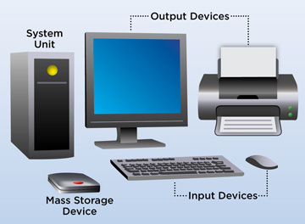
Computer A computer is a machine or device that performs processes, calculations and operations based on instructions provided by a software or hardware program. A computer has the ability to: accept data (input) process it produce outputs store it for later use

Slide 12
Computer A computer is a machine or device that performs processes, calculations and operations based on instructions provided by a software or hardware program. A computer has the ability to: accept data (input) process it produce outputs store it for later use

Slide 13
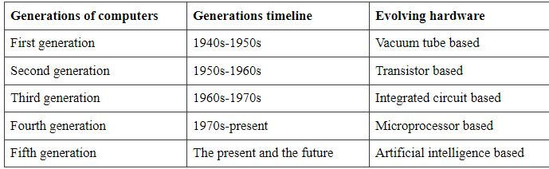
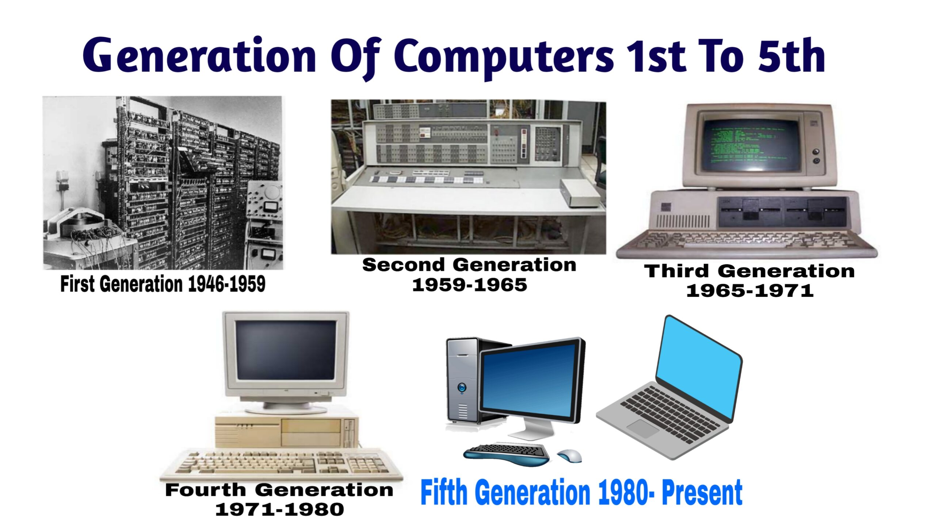
Evolution of Computers

Slide 14
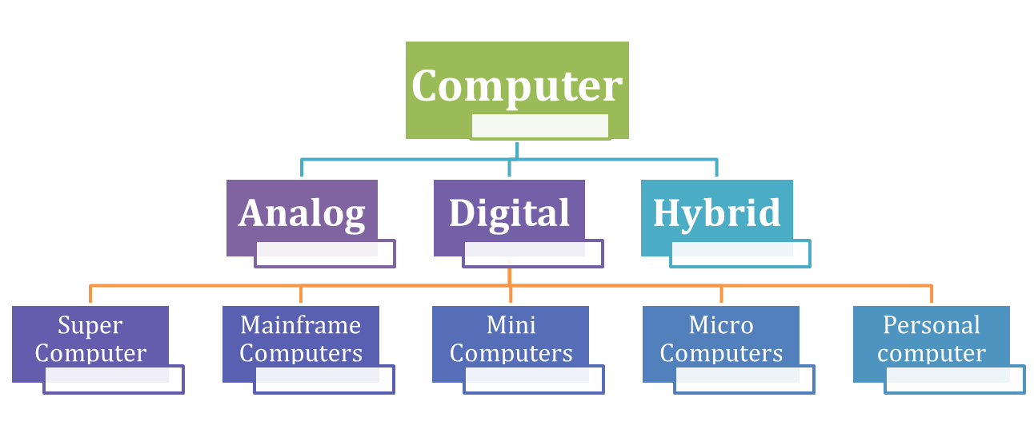
Classification of Computers

Slide 15
Computer Science Computer science is the study of computers, including computational theory, hardware and software design, algorithms and the way humans interact with technology.

Slide 16
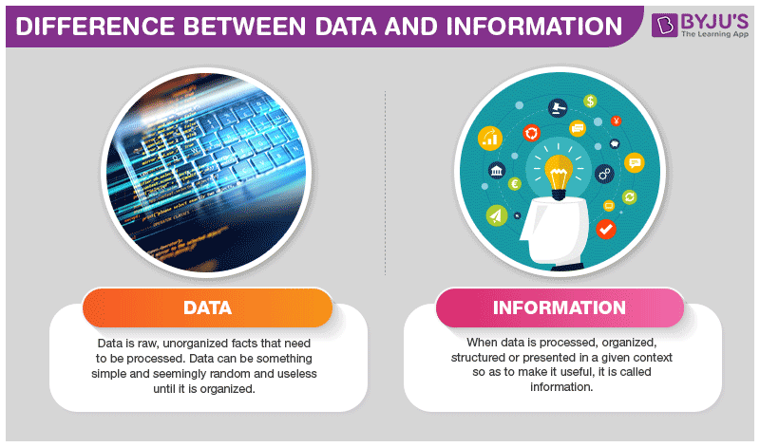
Notes:
Data is a collection of facts, while information puts those facts into context.

Slide 17
Basic Computer Terminologies
CPU
CPU means ‘Central Processing Unit’. This is the place of
computer data handling. Moreover, it does all the data
manipulation, calculations and formatting data for output.
RAM
Specifically, RAM stands for “Random Access Memory” or “Ready Access Memory”. It is a temporary notepad where your computer sends information to disk, or to the storage place of instructions from other input devices.

Slide 18
Basic Computer Terminologies
Hard-disk Drive
Your computers hard disk drive is like an audio CD that you possess at home – except your computer can read and write to it. In other words, your computer can take data from your hard drive (to process it in the CPU or place it in RAM to work with).
Hardware
Hardware is the term referring to all the physical parts in a computer system. It includes the monitor, the keyboard, the mouse, the main case which stores the RAM, CPU and the motherboard.

Slide 19
Basic Computer Terminologies
Software
‘Software’ is the term which refers to the instructions needed to make a computer work. It is intangible in nature. The software is also known as a “program”. Also, it is a set of computer files which are used to perform various actions on the computer. Google Chrome, MS Office, Gmail, Facebook
are examples of software.

Slide 20
Basic Computer Terminologies
Application Software
Uses the computer system to perform special functions or provide entertainment functions beyond the basic operation of the computer itself.
System Software
It directly operates the Computer Hardware, to provide basic functionality needed by users and other software, and to provide a platform for running application software

Slide 21
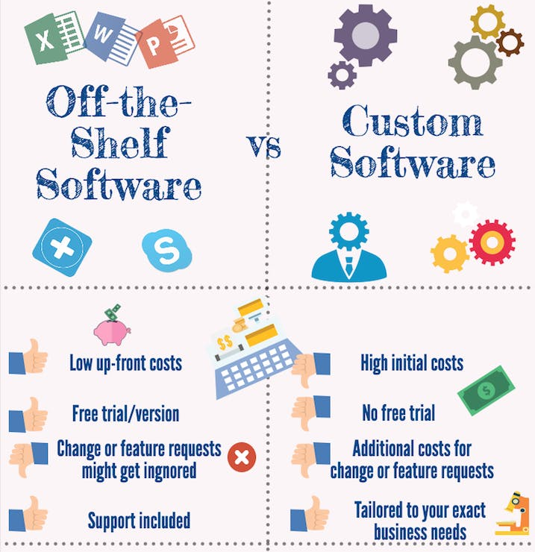

Slide 22
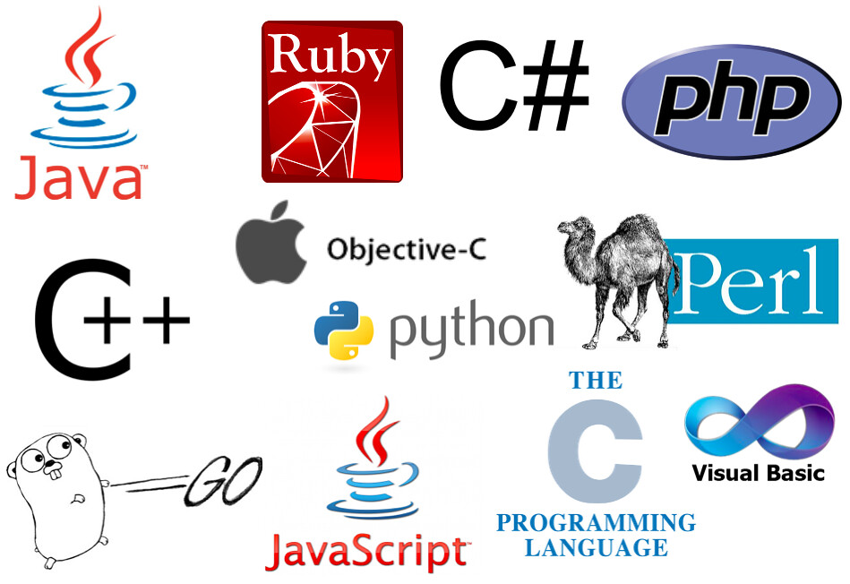
Computer Languages
The user of a computer must be able to communicate with it. That means, he must be able to give the computer commands and understand the output that the computer generates. This is possible due to the invention of computer languages.

Slide 23
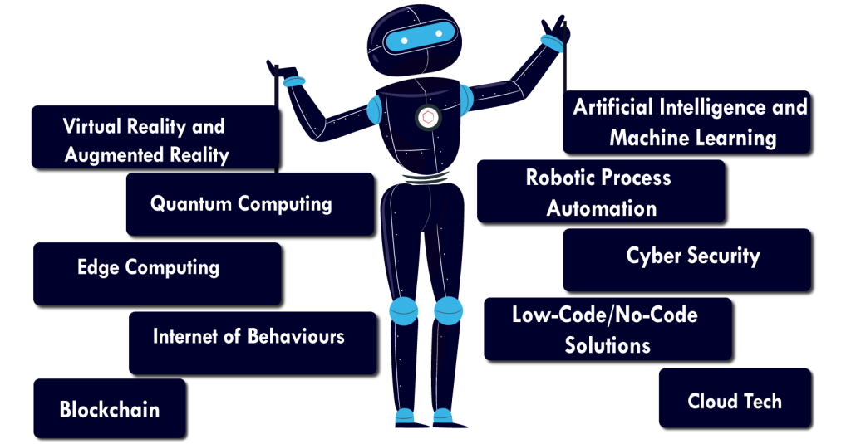
Technology Trends in 2022
Notes:
Virtual Reality and Augmented Reality:
Augmented reality (AR) adds digital elements to a live view often by using the camera on a smartphone. Examples of augmented reality experiences include Snapchat lenses and the game Pokemon Go.
Virtual reality (VR) implies a complete immersion experience that shuts out the physical world.
Quantum computing is an area of study focused on the development of computer based technologies centered around the principles of quantum theory. Quantum theory explains the nature and behavior of energy and matter on the quantum (atomic and subatomic) level. Quantum computing uses a combination of bits to perform specific computational tasks.
Edge computing is a distributed computing paradigm that brings computation and data storage closer to the sources of data. This is expected to improve response times and save bandwidth. It is an architecture rather than a specific technology.
IoB is a process where user data is analyzed in terms of behavioral psychology. Based on this analysis, new approaches to the development of user experience (UX), search experience optimization (SXO), and end products and companies' services and how to promote them are formed.
Blockchain is a shared, immutable ledger that facilitates the process of recording transactions and tracking assets in a business network. An asset can be tangible (a house, car, cash, land) or intangible (intellectual property, patents, copyrights, branding).
A Blockchain is a chain of blocks that contain information. The data which is stored inside a block depends on the type of blockchain. For Example, A Bitcoin Block contains information about the Sender, Receiver, number of bitcoins to be transferred.
Artificial intelligence is intelligence demonstrated by machines, makes it possible for machines to learn from experience, adjust to new inputs and perform human-like tasks.
Face Detection and recognition.
Text Editors and Autocorrect.
Chatbots.
E-Payments.
Search and Recommendation algorithms.
Robotic process automation (RPA) is a software technology that makes it easy to build, deploy, and manage software robots that emulate humans actions interacting with digital systems and software.
Cybersecurity is the protection of internet-connected systems such as hardware, software and data from cyberthreats. The practice is used by individuals and enterprises to protect against unauthorized access to data centers and other computerized systems.
Low-code/no-code development platforms are types of visual software development environments that allow enterprise developers and citizen developers to drag and drop application components, connect them together and create mobile or web apps.
Cloud computing is the on-demand availability of computer system resources, especially data storage and computing power, without direct active management by the user.

